Slide 1
[20260812] PCCP Topic #2 Greedy Dynamic Programming AX Development Team Nguyen Thi Binh An

Slide 2
Greedy

Slide 3

Greedy Algorithm Definition
Solution is determined based on making the locally optimal choice at any given moment. In other words, we choose the best decision from the viewpoint of the current stage of the solution.
Trade off
If it is not the best approach, then it often returns a result which is approximately correct but suboptimal.
On the other hand, if it works correctly, its running time is usually faster than those of dynamic programming or brute-force

Slide 4



Assign Candy
3 3 4 5 8
1 1 2 4 4 10

Slide 5

Best time to buy and sell stock

Slide 6

Canoeist
1 2 3 4 5
K = 6

Slide 7


Coin Change
1 2 5
13

Slide 8
Coin Change
1 3 4
6

Slide 9
Dynamic Programming

Slide 10
Dynamic Programming Algorithm Definition
Solution is determined based on solving successively similar but smaller problems.
Bigger problem is relatively easy to find, if we have solutions for its sub-problems.
Use memory for caching

Slide 11
Steps
Identify the Problem :
overlapping subproblems
optimal substructure
Define states (1D, 2D mem..)
Find the relationships (formula)
Base Cases : Simplest Version
Choose top-down or bottom-up

Slide 12
Fibonacci
0 1 1 2 3 5 8 13 15 28 43 …
0 1 2 3 4 5 6 7 8 9 10

Slide 13
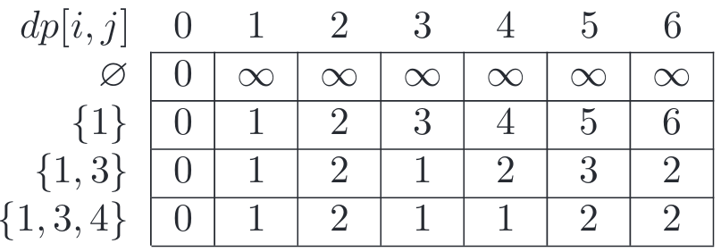
Coin Change
6
1
3
4

Slide 14
Time for code..
Nguyen Thi Binh An
AX Development Team
an.ntb@lgcns.com

Slide 15
